Slide 1
eSubmission Web Client – XML delivery files
Changes introduced in v3.4.0.0
Presented by Hanna Palyszka on 06 March 2018

Slide 2
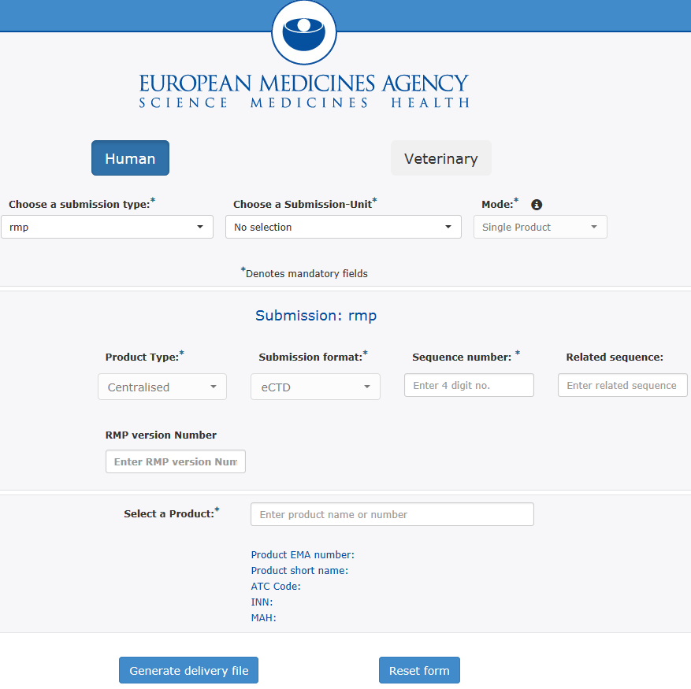
1.Related sequence number
Users can now optionally enter the related sequence number for most types of Human submissions. This allows for easy cross referencing of related submissions.
1

Slide 3
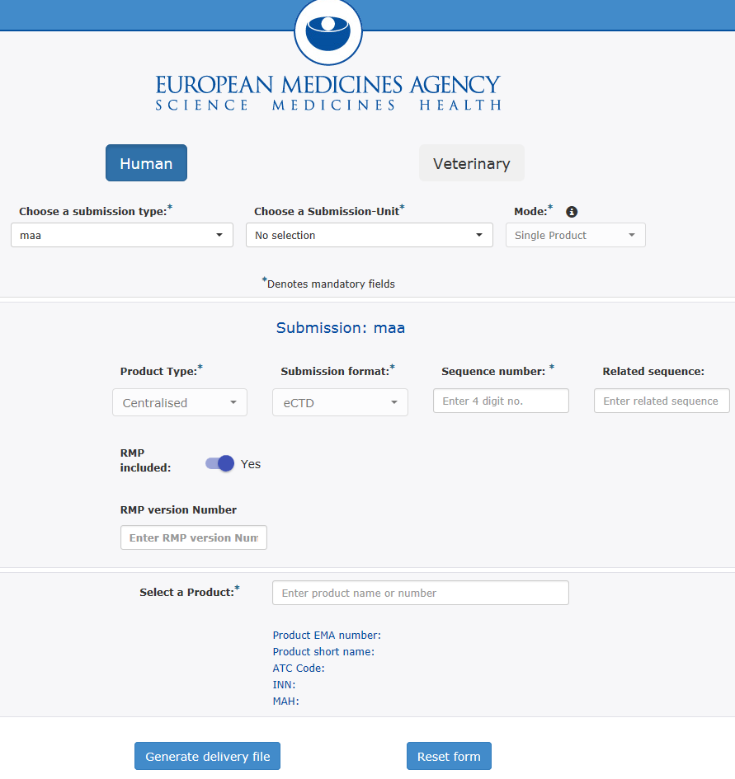
2. Identify if RMP included
Users can now identify whether a Risk Management Plan is included for the following type of submissions:
MAA
Variation Type IB
Variation Type II
Extension
PAM
Renewal
2

Slide 4
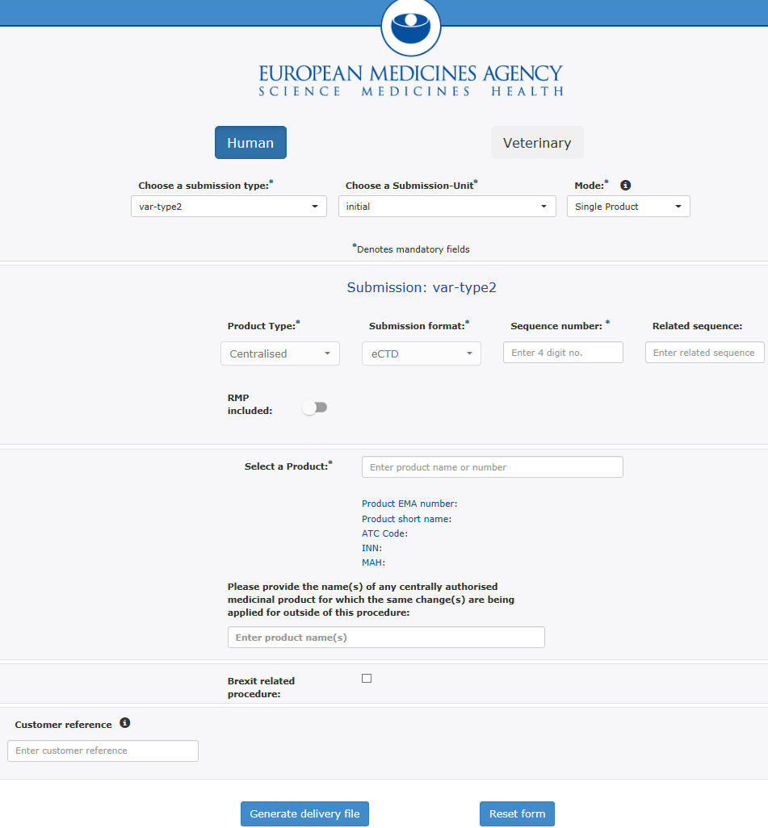
3. Other CAPS where same change applies
Users can now provide the name of any CAPs for which the same changes are being applied outside of the procedure. This is applicable to the following types of submissions:
Variations Type IB
Variations Type II
3

Slide 5
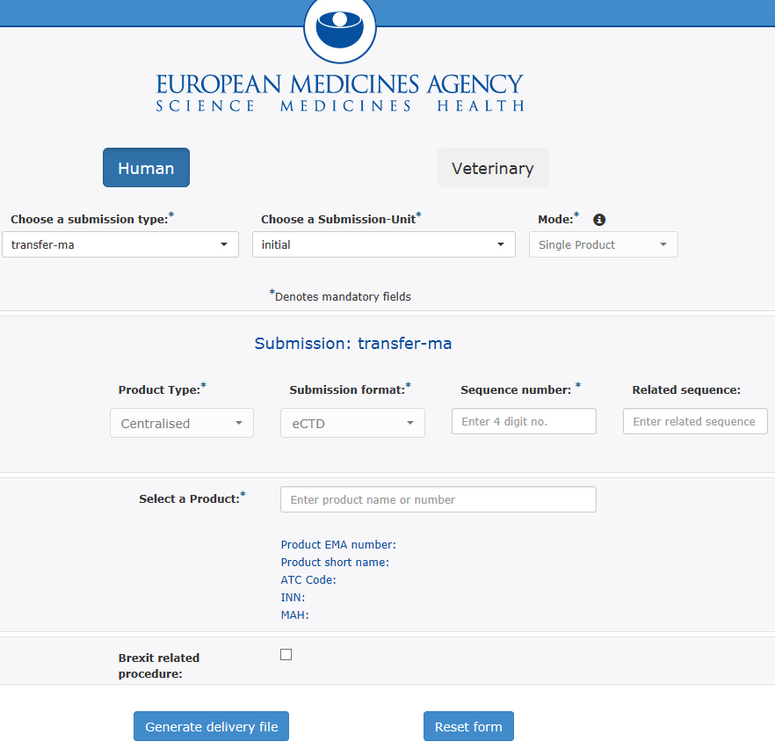
4. Brexit related procedures
Users can indicate if the change is a Brexit related procedure. This is applicable to initial submissions for the following submission types:
Variations Type IA (H & V)
Variations Type IAIN (H & V)
Variations Type IB (H & V)
Variations Type II (H & V)
Transfer MA (H & V)
Notification 61-3 (H only)
4

Slide 6
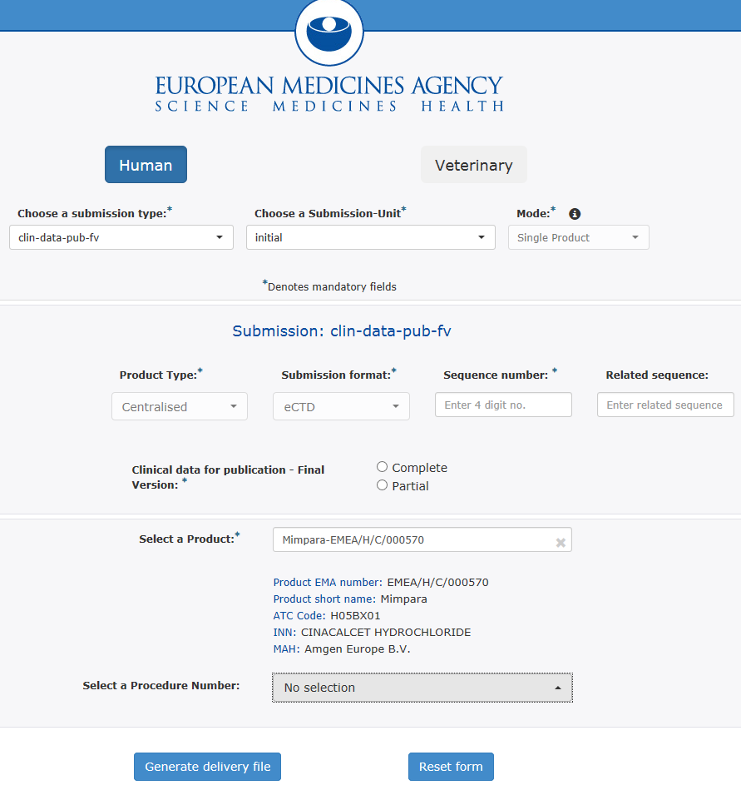
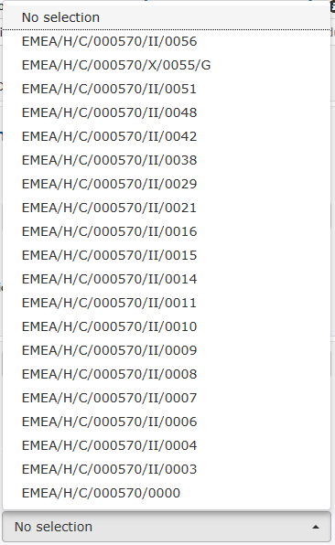
4. Clinical data – Select procedure number
Users can now select from a predefined list of procedure number to reference the submission. This is applicable for the following clinical data submissions types.
Clinical data publication-FV
Clinical data publication-RP
5
Training on updated eSubmission Gateway XML delivery files - 08 March 2018

Slide 7
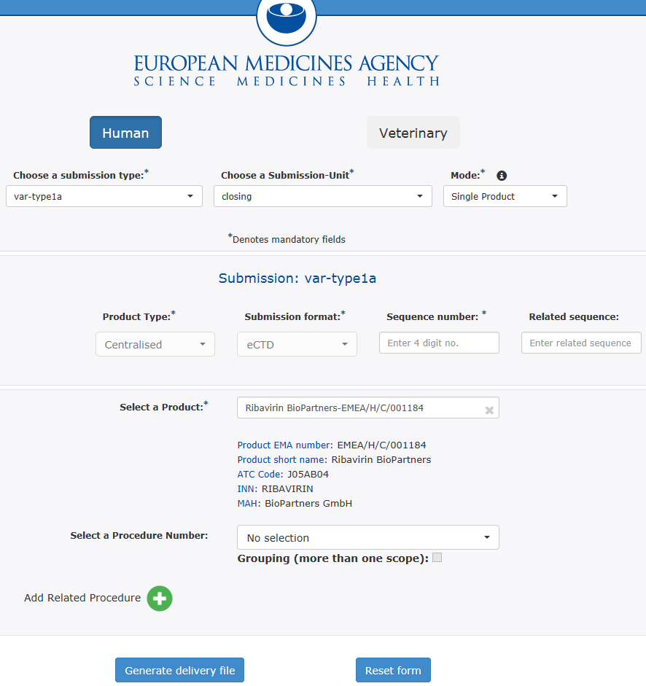
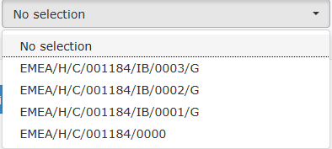
5. CAPS - Add multiple procedure numbers
Users can now add multiple procedure numbers from a predefined list to reference the submission. This is applicable for all post authorisation CAP submissions when the submission unit is closing.
6

Slide 8
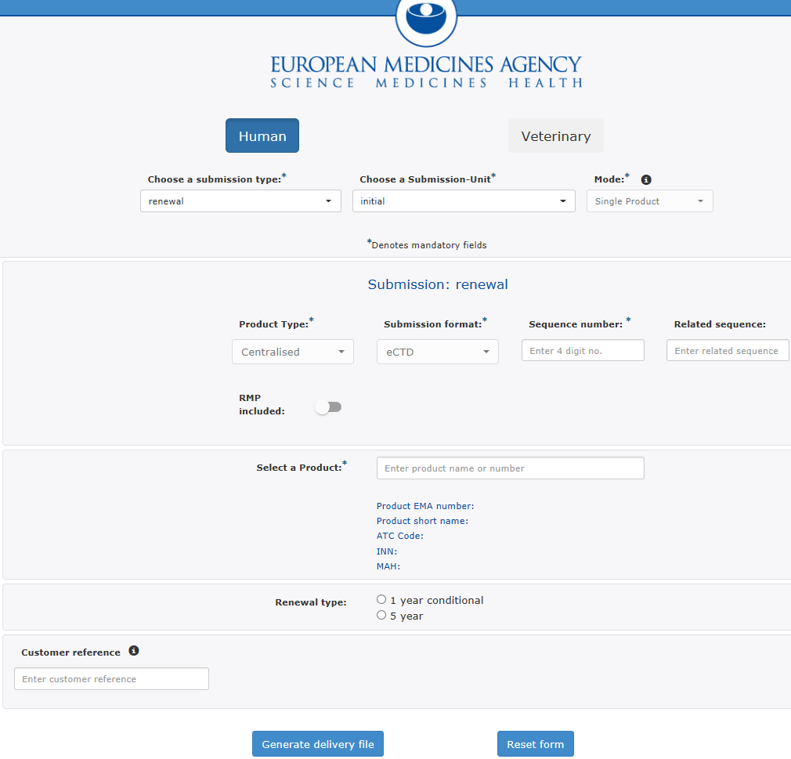
6. Addition of type of Renewal
Users can now specify the length of the renewal by selecting the radio button. This is applicable for all initial renewal submissions.
7

Slide 9
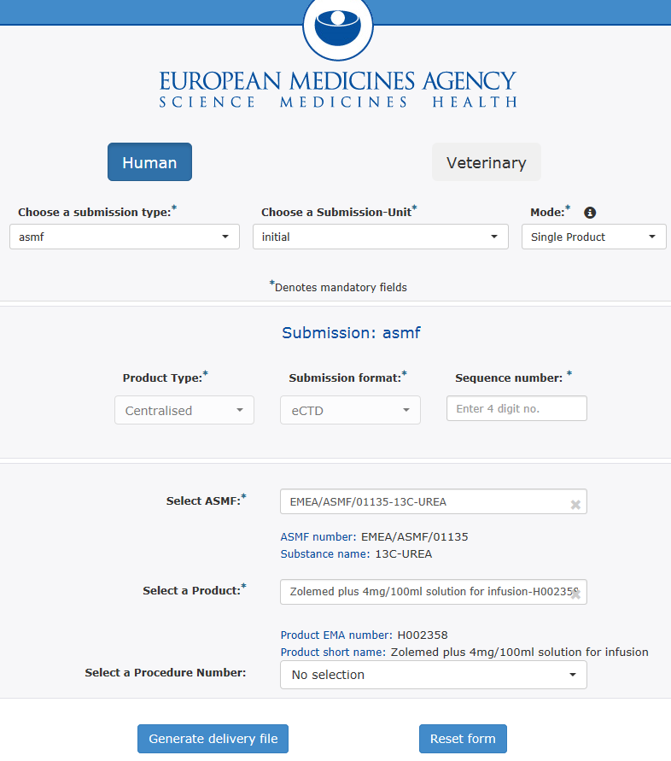
7. ASMF – Select procedure number
Users can now select from a predefined list of procedure number to reference the submission. This is applicable for all ASMF submissions types.
8

Slide 10
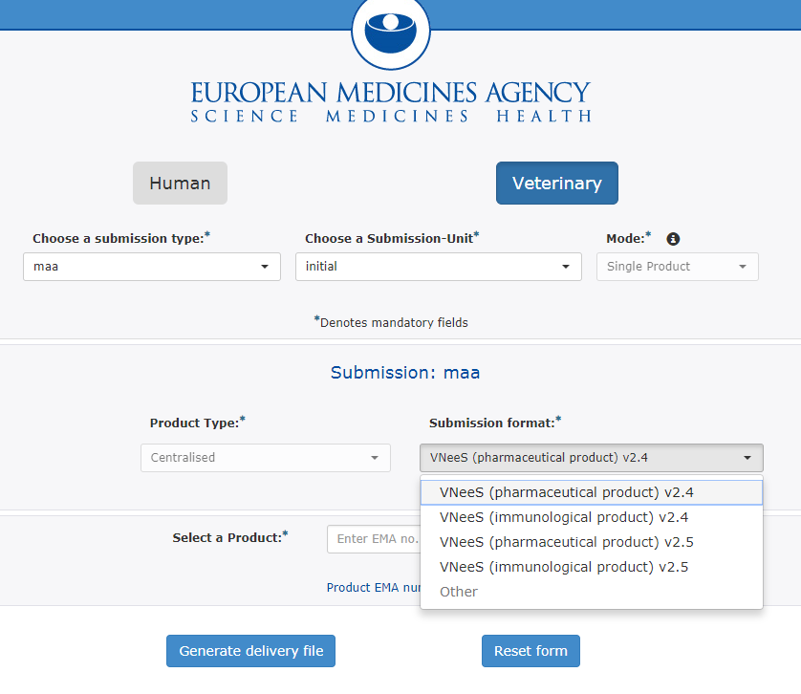
8. Vnees – New Validation set
Users can now select from a new validation set for Veterinary Vnees submissions. This includes:
VNeeS (pharmaceutical product) v.2.5
VNeeS (immunological product) v.2.5
9

Slide 11
Thank you for your attention
Further information
https://servicedesk.ema.europa.eu
European Medicines Agency
30 Churchill Place • Canary Wharf • London E14 5EU • United Kingdom
Telephone +44 (0)20 3660 6000 Facsimile +44 (0)20 3660 5555
Send a question via our website www.ema.europa.eu/contact
Follow us on @EMA_News
Notes:
Note: This slide is OPTIONAL. It uses the 'Closing slide' layout. Delete if not needed.

